Slide 1
What is ‘TWP’ & why is it important for anti-corruption research and practice?
Dr Heather Marquette
Director, Developmental Leadership Program/GSDRC
Steering Committee member, Thinking & Working Politically Community of Practice
Joint British Academy/DFID Anti-Corruption Evidence Programme & Thinking and Working Politically Community of Practice meeting, London, 13 May 2016

Slide 2
Thinking & Working Politically Community of Practice
Started in November 2013 - 8 meetings so far
Next meetings – 8 September, Birmingham; late September, Washington; January, Jakarta; others being discussed for Singapore & Nairobi
Bringing together donors with leading thinkers (NGOs, academics, think tanks, implementers)
An informal community at this point but likely to become a bit more formal as we grow (e.g., new steering committee)
Aims:
Promote TWP within organisations
Build up evidence base on what works, when & why
Agnostic about methods & approaches – no ‘right way’ to TWP
Provide ‘safe space’ to discuss challenges of TWP, working more flexibly etc. – openness, trust, honesty, camaraderie

Slide 3
TWP Community of Practice as a ‘safe space’

Slide 4
What does it mean to ‘think & work politically’ (TWP)?
Three core principles behind TWP:
Strong political analysis, insight & understanding
Detailed appreciation of, and response to, the local context
Flexibility and adaptability in programme design & implementation
See https://ejavenell.files.wordpress.com/2016/01/the-case-for-thinking-and-working-politically1.pdf
Plain English:
Don’t just say ‘there’s a lack of political will’…unpack this!
No ‘best practice’ but ‘best fit’ instead; work with the grain; be ready to act; don’t mess things up!
Don’t get stuck on one course of action; test, adapt, change – you may like your model in theory but kill it if it doesn’t work in practice!

Slide 5
The TWP Spectrum
Thomas Parks (2014), presentation to TWP CoP

Slide 6
What makes for good TWP & why doesn’t it happen all the time?
Iterative, adaptive programme design
Focus on brokering relationships & working with the grain of local politics
Politically-well informed staff who know what to do with knowledge
Local actors take the lead
Flexible, strategic funding
Long-term commitment from funders
High continuity with staffing
?? Politically-minded staff??
Need to have a full design in place from the beginning to prove ‘VFM’ & get approval
Spending targets not rooted in local reality
Regular reporting against pre-approved targets
External actors take the lead
Unrealistic short time frames
High staff turnover, no institutional memory, no proper handover
Few country experts
??Not enough political scientists??
Adapted from Booth & Unsworth 2014

Slide 7
What does TWP mean for anti-corruption?
‘I was then told that there was one word I could not use, which was the “C” word, the “C” word being corruption. Corruption, you see, was identified with politics, and if I got into that, I would have a terrible time with my Board. Well, I then visited quite a number of countries, and I decided in 1996 that I would redefine the “C” word not as a political issue but as something social and economic’ – James Wolfensohn, 1997
And here we are, 20 years later…

Slide 8
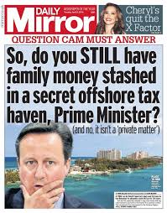
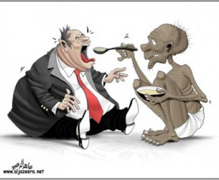
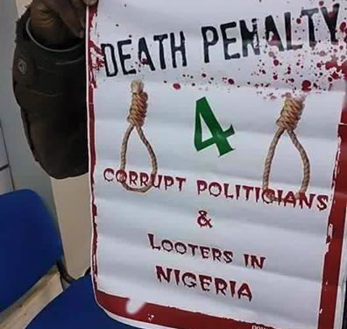
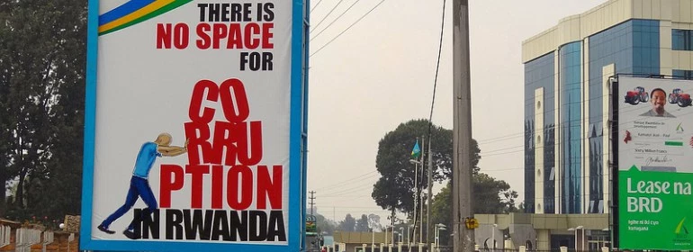
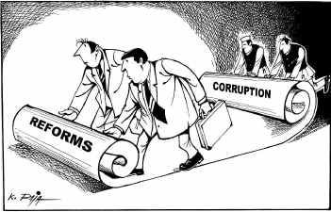
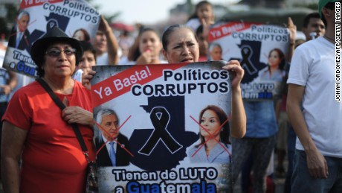
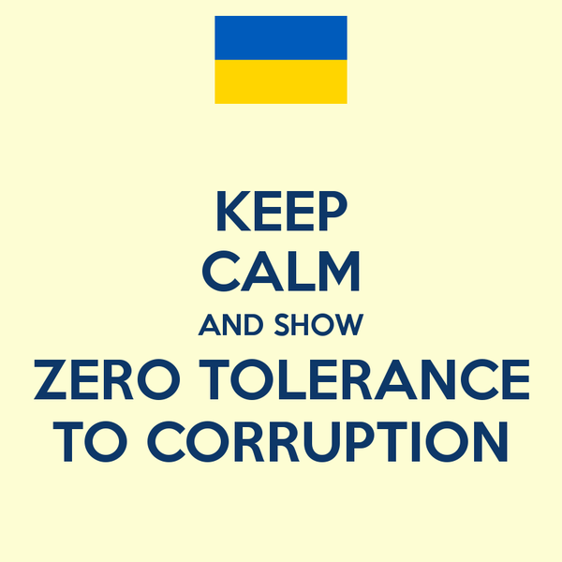
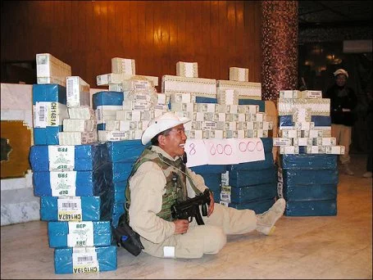
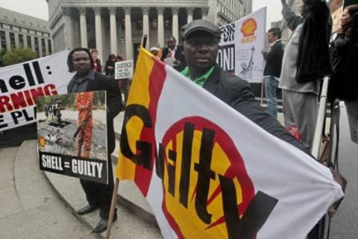
Can there be a technical non-political approach to anti-corruption?

Slide 9
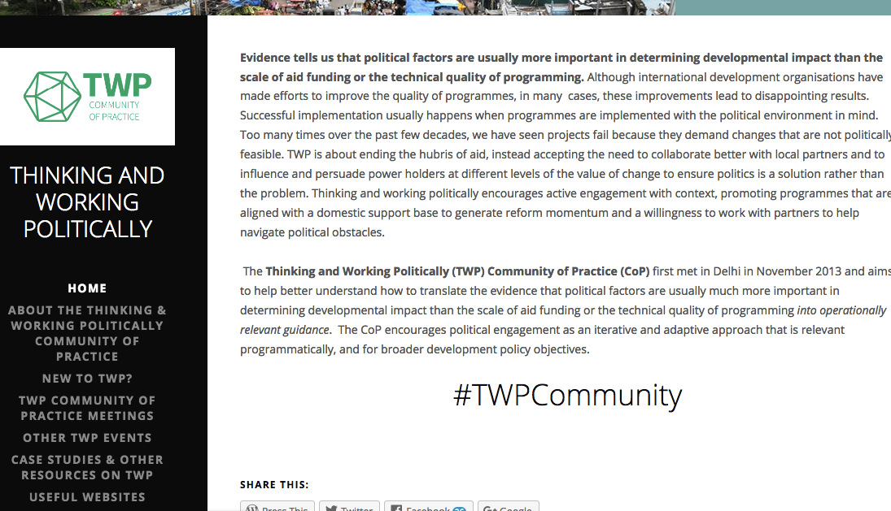
http://twpcommunity.org
@TWP_Community
#TWPCommunity

